Slide 1
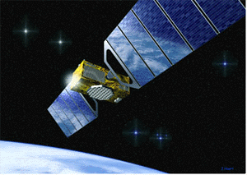
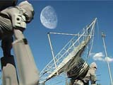
SATELLITE
COMMUNICATIONS
Satellite Communications
Dr. C. SARITHA
Lecturer in Electronics
SSBN Degree College
ANANTAPUR

Slide 2
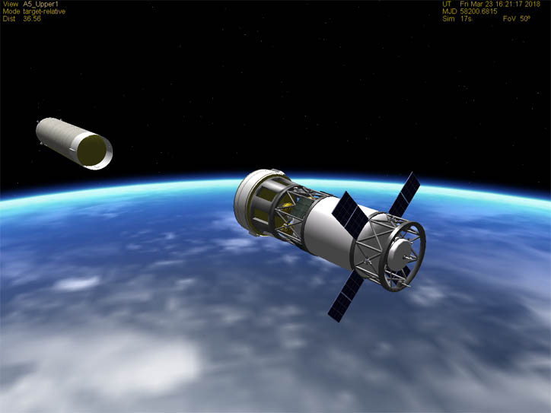

Contents…
Introduction
Orbit
Keplers laws
Frequency Allocation
Advantages of satellite/ Applications
Disadvantages
Conclusion
Satellite Communications

Slide 3
Introduction
Satellite is a microwave repeater in the space.
There are about 750 satellites in the space, most of them are used for communication.
They are:
  Wide area coverage of the earth’s surface.
  Transmission delay is about 0.3 sec.
  Transmission cost is independent of distance.
Satellite Communications

Slide 4
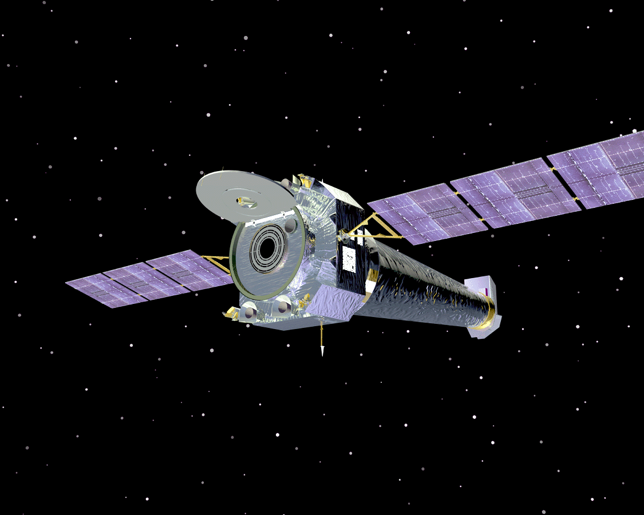
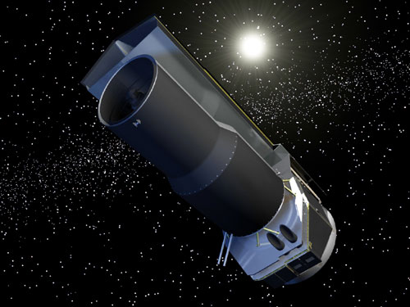
What exactly is a satellite?
The word satellite originated from the Latin word “Satellit”- meaning an attendant, one who is constantly hovering around & attending to a “master” or big man.
For our own purposes however a satellite is simply any body that moves around another (usually much larger) one in a mathematically predictable path called an orbit.
Satellite Communications

Slide 5
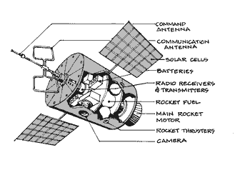
Components of a satellite
Satellite Communications

Slide 6
What are Communication Satellites?
A satellite is an object that orbits another large object like planet.
A communication satellite is a station in space that is used for telecommunication, radio and television signals.
The first satellite with radio transmitter was in 1957.
Satellite Communications

Slide 7
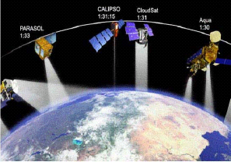
Communication Satellites
Satellite Communications

Slide 8
The origin of satellite
The concept of using object in space to reflect signals for communication was proved by Naval Research Lab in Washington D.C. when it use the Moon to establish a very low data rate link between Washington and Hawaii in late 1940’s.
Russian started the Space age by successfully launching SPUTNIK the first artificial spacecraft to orbit the earth, which transmitted telemetry information for 21 days in Oct. 1957.
Satellite Communications

Slide 9
Cont…
The American followed by launching an experimental satellite EXPLORER In 1958.
In 1960 two satellite were deployed “Echo” & “Courier”
In 1963 first GSO “Syncom” The first commercial GSO (Intelsat & Molnya) in 1965 these provides video (Television) and voice (Telephone)
Satellite Communications

Slide 10
Why Use Satellite?
Satellite communication is just one example of wireless communication systems.
Familiar examples of wireless systems are all around us, such as radio, television- broadcasting, mobile and cordless telephones.
These systems rely on a network of ground-based transmitters and receivers and for this reason they are often referred to as “ terrestrial " systems.
Satellite Communications

Slide 11
Cont…
One major use of satellites familiar to everyone is satellite television broadcasting.
Other applications of satellite communications include high speed internet, telephony and corporate networks for multinational businesses.
Satellite Communications

Slide 12
How do satellites work?
Two Stations on Earth want to communicate through radio broadcast but are too far away to use conventional means.
The two stations can use a satellite as a relay station for their communication.
One Earth Station sends a transmission to the satellite. This is called a Uplink.
Satellite Communications

Slide 13
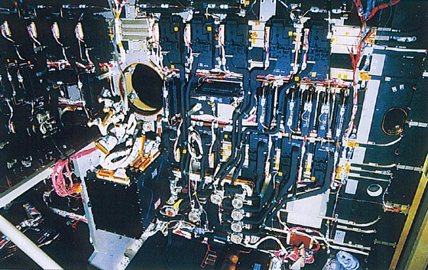
The satellite Transponder converts the signal and sends it down to the second earth station. This frequency is called a Downlink.
Transponder
Satellite Communications

Slide 14
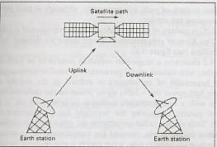
Concept:
Satellite Communications

Slide 15
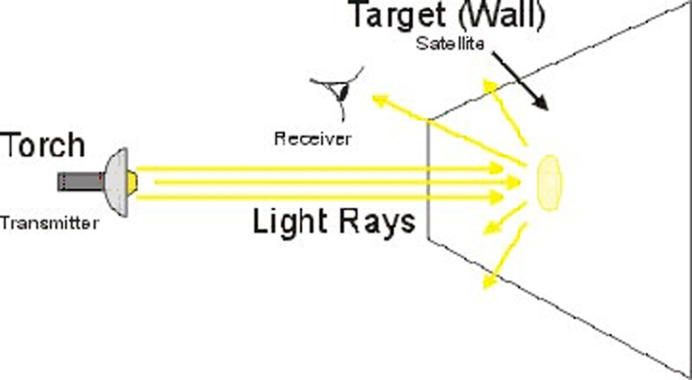
Consider the light bulb as an example:
Satellite Communications

Slide 16
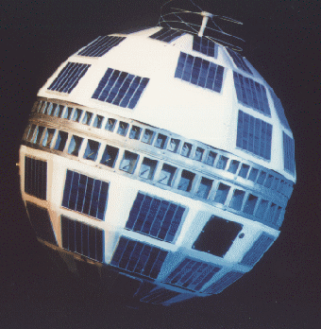
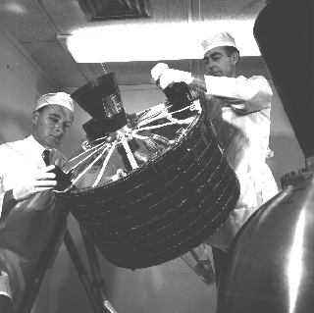
Early satellites
Telstar
Allowed live transmission across the Atlantic
Syncom 2
  First Geosynchronous satellite.
  TELSTAR SYNCOM 2
Satellite Communications

Slide 17
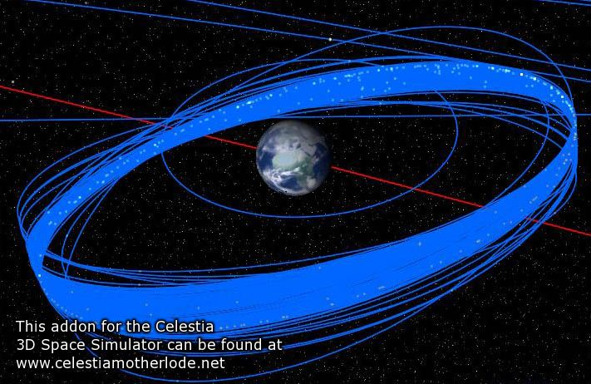
Orbits
Circular orbits are simplest.
Inclined orbits are useful for coverage of equatorial regions
Elliptical orbits can be used to give quasi stationary behaviour viewed from earth using
3 or 4 satellites
Orbit changes can be used to extend the life of satellites.
Satellite Communications

Slide 18
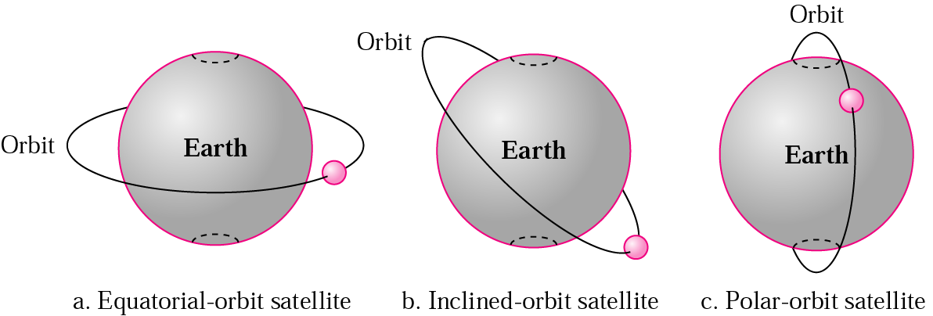
Satellite orbits
Classification of orbits:
Satellite Communications

Slide 19
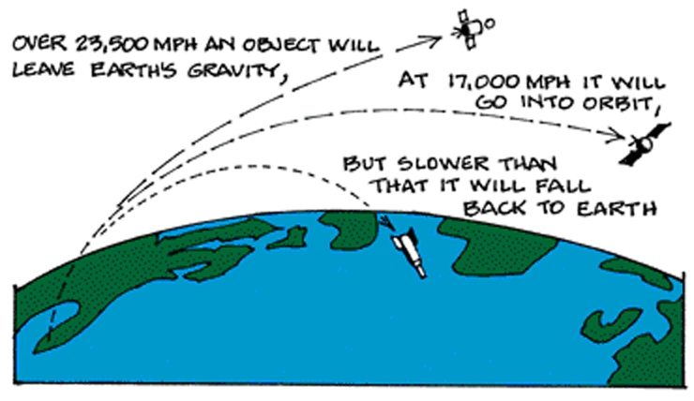
How does a satellite stay in it’s orbit?
Satellite Communications

Slide 20
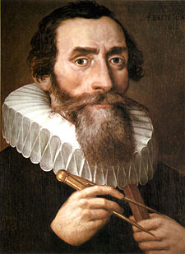
Origin of planetary laws
Derived 3 laws based
upon his observations
of planetary motion.
Sir. Johannes Kepler
Satellite Communications

Slide 21
The 3 Laws of Planetary Motion
Planets move in elliptical orbits with the sun at one of the foci.
The line joining the sun and the planet sweeps out equal areas in equal times.
The cube of the distance of the planet from the sun is proportional to the square of the period. r3 ά T2
Satellite Communications

Slide 22
Kepler’s 1st Law: Law of Ellipses
The orbits of the planets are ellipses with the sun at one focus
Satellite Communications

Slide 23
Kepler’s 2nd Law: Law of Equal Areas
The line joining the planet to the center of the sun sweeps out equal areas in equal times
T4
T5
T3
T2
A4
A3
T1
A5
A2
A1
T6
A6
Satellite Communications

Slide 24
Kepler’s 3rd Law: Law of Harmonics
The squares of the periods of two planet’s orbits are proportional to each other as the cubes of their semi-major axes:
T1²/T2² = a1³/a2³
In English:
Orbits with the same semi-major axis will have the same period
Satellite Communications

Slide 25
Elements of Satellite
Communications
The basic elements of a communication satellite service are divided between;
Space Segment
Ground Segment
The space segment consist of the spacecraft & launch mechanism.
The ground segment comprises the earth station and network control center of entire satellite system.
Satellite Communications

Slide 26
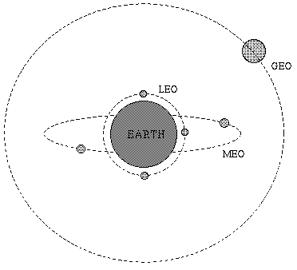
Space Segment
Space segment consist of a satellite in suitable orbit.
Space segment classified on the basis of orbit.
LEO
MEO
GEO
MONIYA
HAP
Satellite Communications

Slide 27
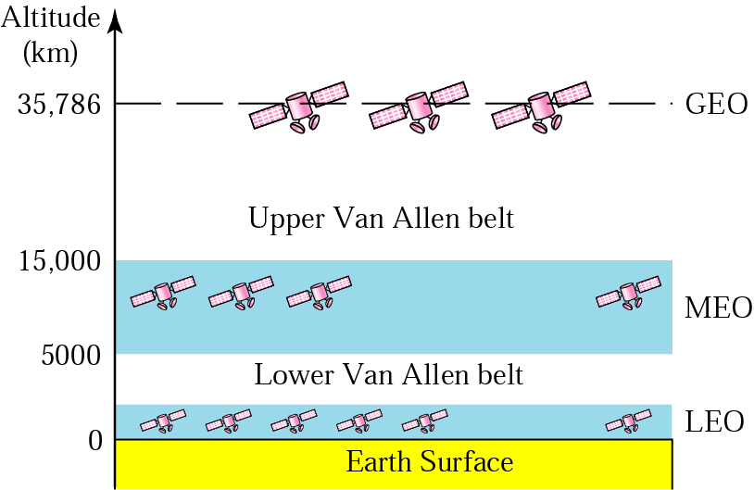
Satellite orbit altitudes
Satellite Communications

Slide 28
Ground Segment
The ground Segment of each service has
distinct characteristics.
Services like;
FSS
BSS
MSS
Maritime, Aeronautical & Land base
DBS etc..
Satellite Communications

Slide 29
Service Types
  Fixed Service Satellites (FSS)
    Example: Point to Point Communication
  Broadcast Service Satellites (BSS)
    Example: Satellite Television/Radio
    Also called Direct Broadcast Service (DBS).
  Mobile Service Satellites (MSS)
    Example: Satellite Phones
Satellite Communications

Slide 30
Low Earth Orbit (LEO)
LEO satellites are much closer to the earth than GEO satellites, ranging from 500 to 1,500 km above the surface.
LEO satellites don’t stay in fixed position relative to the surface, and are only visible for 15 to 20 minutes each pass.
A network of LEO satellites is necessary for LEO satellites to be useful.
Satellite Communications

Slide 31
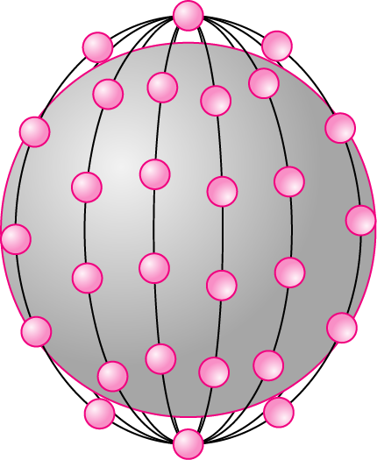
The Iridium system has 66 satellites in six LEO orbits,
each at an altitude of 750 km.
Iridium is designed to provide direct worldwide voice and data communication using handheld terminals, a service similar to cellular telephony but on a global scale
Satellite Communications

Slide 32
Advantages:
  A LEO satellite’s proximity to earth compared to a GEO satellite gives it a better signal strength and less of a time delay, which makes it better for point to point communication.
  A LEO satellite’s smaller area of coverage is less of a waste of bandwidth.
Satellite Communications

Slide 33
Disadvantages:
  A network of LEO satellites is needed, which can be costly
  LEO satellites have to compensate for Doppler shifts cause by their relative movement.
  Atmospheric drag effects LEO satellites, causing gradual orbital deterioration.
Satellite Communications

Slide 34
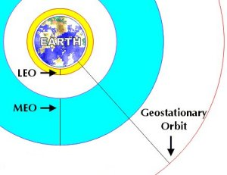
Medium Earth Orbit (MEO)
A MEO satellite is in orbit somewhere between 8,000 km and 18,000 km above the earth’s surface.
MEO satellites are similar to LEO satellites in functionality.
MEO satellites are visible for much longer periods of time than LEO satellites, usually between 2 to 8 hours.
MEO satellites have a larger coverage area than LEO satellites.
Satellite Communications

Slide 35
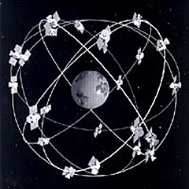
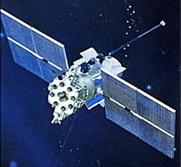
MEO satellites
The GPS constellation calls for 24 satellites to be distributed equally among six circular orbital planes
Glonass (Russian)
Satellite Communications

Slide 36
Advantage
  A MEO satellite’s longer duration of visibility and wider footprint means fewer satellites are needed in a MEO network than a LEO network.
Disadvantage
  A MEO satellite’s distance gives it a longer time delay and weaker signal than a LEO satellite, though not as bad as a GEO satellite.
Satellite Communications

Slide 37
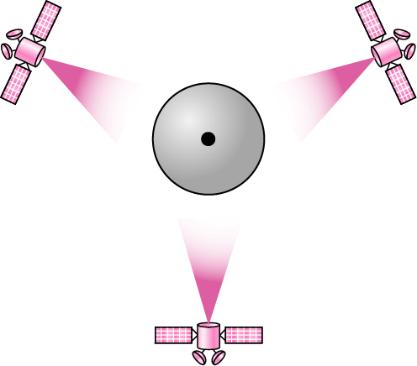
Geostationary Earth Orbit (GEO)
These satellites are in orbit 35,863 km above the earth’s surface along the equator.
Objects in Geostationary orbit revolve around the earth at the same speed as the earth rotates. This means GEO satellites remain in the same position relative to the surface of earth.
Satellite Communications

Slide 38
Advantages:
  A GEO satellite’s distance from earth gives it a large coverage area, almost a fourth of the earth’s surface.
  GEO satellites have a 24 hour view of a particular area.
  These factors make it ideal for satellite broadcast and other multipoint applications.
Satellite Communications

Slide 39
Disadvantages:
  GEO satellite’s distance also cause it to have both a comparatively weak signal and a time delay in the signal, which is bad for point to point communication.
  GEO satellites, centered above the equator, have difficulty broadcasting signals to near polar regions.
Satellite Communications

Slide 40
Other Orbits
Molniya Orbit Satellites
  Used by Russia for decades.
  Molniya Orbit is an elliptical orbit. The satellite remains in a nearly fixed position relative to earth for eight hours.
  A series of three Molniya satellites can act like a GEO satellite.
  Useful in near polar regions.
Satellite Communications

Slide 41
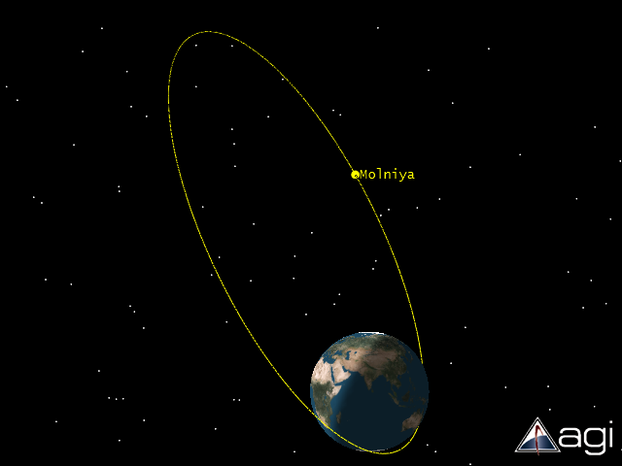
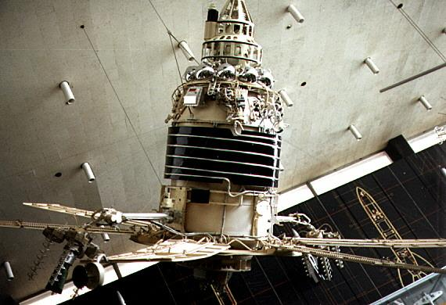
Molniya Orbit
Satellite Communications

Slide 42
High Altitude Platforms (HAPs)
  One of the newest ideas in satellite communication.
  A blimp or plane around 20 km above the earth’s surface is used as a satellite.
  HAPs would have very small coverage area, but would have a comparatively strong signal.
  Cheaper to put in position, but would require a lot of them in a network.
Satellite Communications

Slide 43
Frequency Allocations
Frequency bands for satellite services are shared with terrestrial services.
Satellite signal strength is constrained to avoid interference by it to others.
Thus a large antenna and sensitive receiver are needed at the earth station.
Satellite Communications

Slide 44
Cont…
Frequency sharing techniques are an important study area.
Many satellites have to share a limited frequency band (and limited orbital arc) thus coordination in frequency and orbital location is important.
Frequency allocation are done by international agreements.
Satellite Communications

Slide 45
Frequency Bands
Different kinds of satellites use different frequency bands.
  L–Band: 1 to 2 GHz, used by MSS
  S-Band: 2 to 4 GHz, used by MSS, NASA, deep space research
  C-Band: 4 to 8 GHz, used by FSS
  X-Band: 8 to 12.5 GHz, used by FSS and in terrestrial imaging, ex: military and meteorological satellites
  Ku-Band: 12.5 to 18 GHz: used by FSS and BSS (DBS)
  K-Band: 18 to 26.5 GHz: used by FSS and BSS
  Ka-Band: 26.5 to 40 GHz: used by FSS
Satellite Communications

Slide 46
Advantages of satellite over terrestrial communication
  The coverage area of a satellite greatly exceeds that of a terrestrial system.
  Transmission cost of a satellite is independent of the distance from the center of the coverage area.
  Satellite to Satellite communication is very precise.
  Higher Bandwidths are available for use.
Satellite Communications

Slide 47
Disadvantages of satellites:
  Launching satellites into orbit is costly.
  Satellite bandwidth is gradually becoming used up.
  There is a larger propagation delay in satellite communication than in terrestrial communication.
Satellite Communications

Slide 48
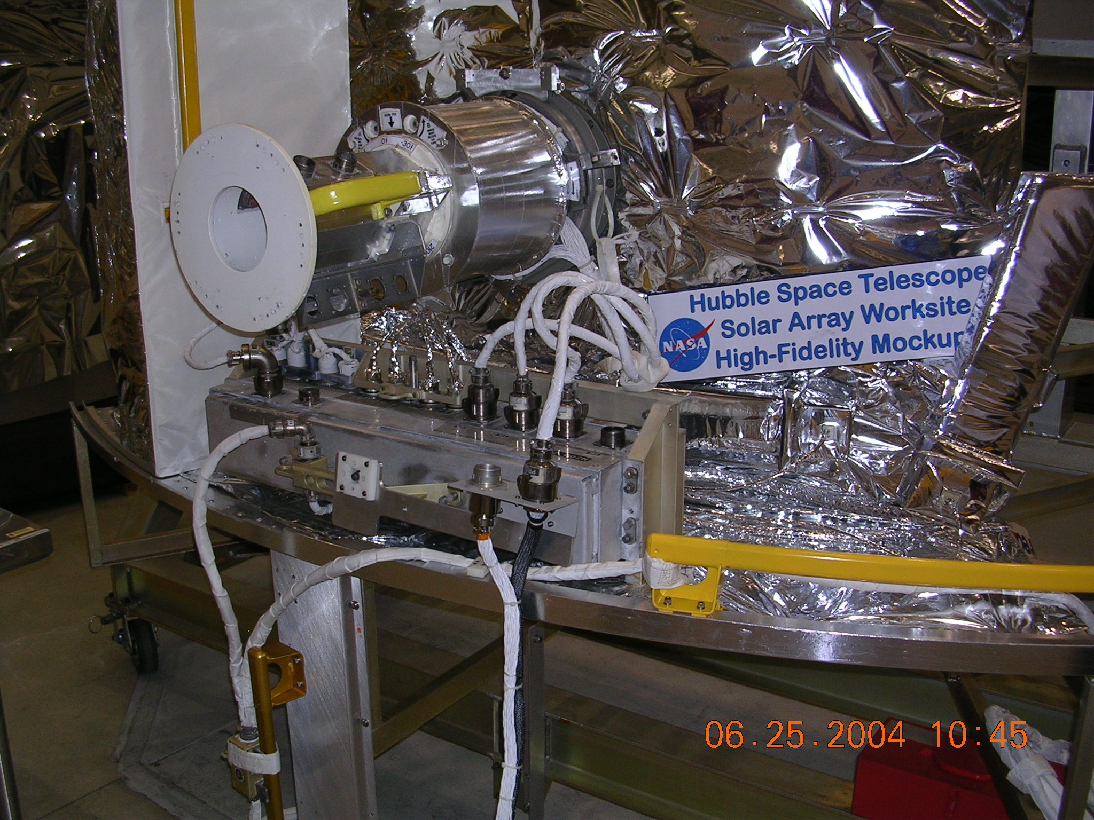
Major problems for satellites
Positioning in orbit
Stability
Power
Communications
Harsh Environment
Satellite Communications

Slide 49
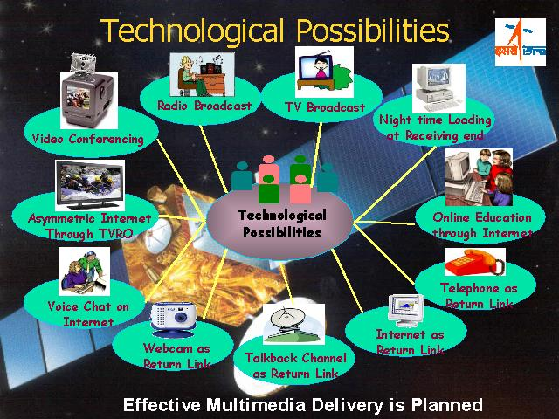
Applications
Satellite Communications

Slide 50
Applications
Telephony
- Fixed points, earth station, Satellite, earth station, fixed points.
Television & Radio
- e.g. Direct broadcast satellite (DBS) & Fixed service satellite (FFS)
Mobile satellite technology
- Special antenna called mobile satellite antenna.
- No matter where or how this antenna is mounted on.
Satellite Communications

Slide 51
Cont…
Amateur radio
- Access to OSCAR satellite.
- Low earth orbits.
Internet
- High Speed.
- Useful for far away places.
Military
- Uses geostationary satellites.
- Example: The Defense Satellite Communications System (DSCS).
Satellite Communications

Slide 52
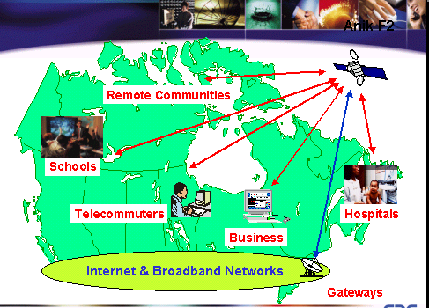
Satellite Communications

Slide 53
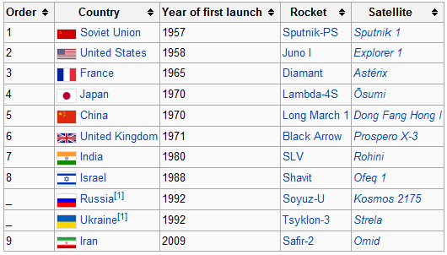
First Launching Of Satellites By Country
Satellite Communications

Slide 54
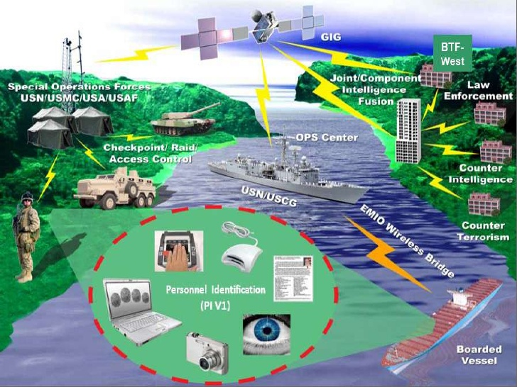
Satellite Communications

Slide 55
In Conclusion
Satellites remain the best utilization used for communications due to their speed and other advantages mentioned in this presentation.
Satellite Communications

Slide 56

Communication satellites bring the world to you anywhere and any time…..
Satellite Communications

Slide 57
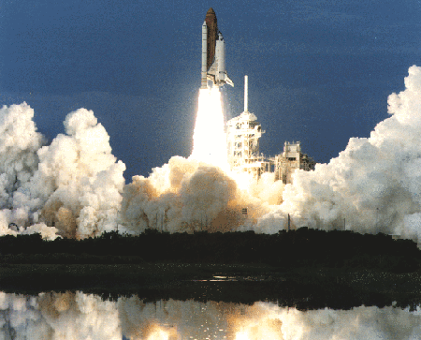
Thank You…..!!!!!
Satellite Communications

